Slide 1

Chapter 10:
Project Communications Management
Information Technology Project Management,
Fourth Edition

Slide 2
Learning Objectives
Understand the importance of good communications in projects.
Explain the elements of project communications planning, including how to create a communications management plan and perform a stakeholder communications analysis.
Describe various methods for distributing project information and the advantages and disadvantages of each, discuss the importance of addressing individual communication needs, and calculate the number of communications channels in a project.

Slide 3
Learning Objectives (cont’d)
Understand how the main outputs of performance reporting help stakeholders stay informed about project resources.
Recognize the importance of good communications management for stakeholder relationships and for resolving issues.
List various methods for improving project communications, such as managing conflicts, running effective meetings, using e-mail and other technologies effectively, and using templates.
Describe how software can enhance project communications management.

Slide 4
Importance of Good Communications
The greatest threat to many projects is a failure to communicate.
Our culture does not portray IT professionals as being good communicators.
Research shows that IT professionals must be able to communicate effectively to succeed in their positions.
Strong verbal skills are a key factor in career advancement for IT professionals.

Slide 5
Project Communications
Management Processes
Communications planning: Determining the information and communications needs of the stakeholders.
Information distribution: Making needed information available to project stakeholders in a timely manner.
Performance reporting: Collecting and disseminating performance information, including status reports, progress measurement, and forecasting.
Managing stakeholders: Managing communications to satisfy the needs and expectations of project stakeholders and to resolve issues.

Slide 6
Communications Planning
Every project should include some type of communications management plan, a document that guides project communications.
Creating a stakeholder analysis for project communications also aids in communications planning.

Slide 7
Communications Management
Plan Contents
Stakeholder communications requirements.
Information to be communicated, including format, content, and level of detail.
The people who will receive the information and who will produce it.
Suggested methods or technologies for conveying the information.

Slide 8
Communications Management
Plan Contents (cont’d)
Frequency of communication.
Escalation procedures for resolving issues.
Revision procedures for updating the communications management plan.
A glossary of common terminology.

Slide 9
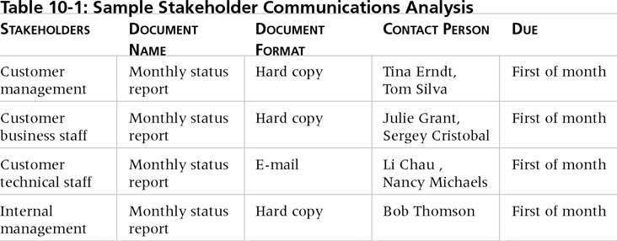
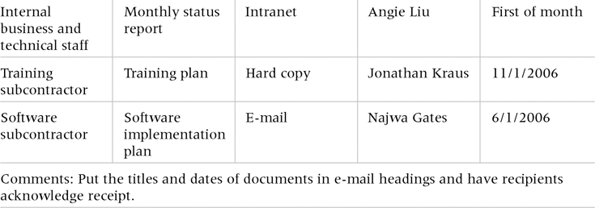
Table 10-1. Sample Stakeholder Analysis for Project Communications

Slide 10
Information Distribution
Getting the right information to the right people at the right time and in a useful format is just as important as developing the information in the first place.
Important considerations include:
  Using technology to enhance information distribution.
  Formal and informal methods for distributing information.

Slide 11
What Went Wrong?
A well-publicized example of misuse of e-mail comes from the 1998 Justice Department's high profile, antitrust suit against Microsoft. E-mail emerged as a star witness in the case. Many executives sent messages that should never have been put in writing. The court used e-mail as evidence, even though the senders of the notes said the information was being interpreted out of context.*
See the example that describes the misunderstanding of the phrase “pedagogical approach” on page 392.
*Harmon, Amy, “E-mail Comes Back to Haunt Companies,” Minneapolis Star Tribune (from the
New York Times) (November 29, 1998).

Slide 12
Distributing Information in an Effective and Timely Manner
Don’t bury crucial information.
Don’t be afraid to report bad information.
Oral communication via meetings and informal talks helps bring important information—good and bad—out into the open.

Slide 13
Importance of Face-to-Face Communication
Research says that in a face-to-face interaction:
  58 percent of communication is through body language.
  35 percent of communication is through how the words are said.
  7 percent of communication is through the content or words that are spoken.
Pay attention to more than just the actual words someone is saying.
A person’s tone of voice and body language say a lot about how he or she really feels.

Slide 14
Encouraging More Face-to-Face Interactions
Short, frequent meetings are often very effective in IT projects.
Stand-up meetings force people to focus on what they really need to communicate.
Some companies have policies preventing the use of e-mail between certain hours or even entire days of the week.

Slide 15
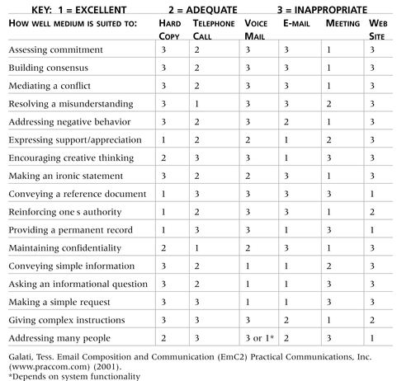
Table 10-2. Media Choice Table

Slide 16
Media Snapshot
Live video is a modern medium for sending information.
Microsoft says that one in every five face-to-face meetings can be replaced with Web conferencing tools, and they estimate it will save $70 million in reduced travel in one year alone.*
The medium can backfire, as in the case with the Janet Jackson wardrobe malfunction during the 2004 Super Bowl half-time show.
*Lohr, Steve, “Ambitious Package to Raise Productivity (and Microsoft’s Profit),” The New York Times (August 16, 2004).

Slide 17
Understanding Group and Individual Communication Needs
People are not interchangeable parts.
As illustrated in Brooks’ book The Mythical Man-Month, you cannot assume that a task originally scheduled to take two months of one person’s time can be done in one month by two people.
Nine women cannot produce a baby in one month!

Slide 18
Personal Preferences Affect Communication Needs
Introverts like more private communications, while extroverts like to discuss things in public.
Intuitive people like to understand the big picture, while sensing people need step-by-step details.
Thinkers want to know the logic behind decisions, while feeling people want to know how something affects them personally.
Judging people are driven to meet deadlines while perceiving people need more help in developing and following plans.

Slide 19
Other Communication Considerations
Rarely does the receiver interpret a message exactly as the sender intended.
Geographic location and cultural background affect the complexity of project communications.
  Different working hours
  Language barriers
  Different cultural norms

Slide 20
Setting the Stage for Communicating
Bad News
Dear Mom and Dad, or should I say Grandma & Grandpa,
Yes, I am pregnant. No, I’m not married yet since Larry, my boyfriend, is out of a job. Larry’s employers just don’t seem to appreciate the skills he has learned since he quit high school. Larry looks much younger than you, Dad, even though he is three years older. I’m quitting college and getting a job so we can get an apartment before the baby is born. I found a beautiful apartment above a 24-hour auto repair garage with good insulation so the exhaust fumes and noise won’t bother us.
I’m very happy. I thought you would be too.
Love, Ashley
P.S. There is no Larry. I’m not pregnant. I’m not getting married. I’m not quitting school, but I am getting a “D” in Chemistry. I just wanted you to have some perspective.

Slide 21
Determining the Number of Communications Channels
As the number of people involved increases, the complexity of communications increases because there are more communications channels or pathways through which people can communicate.
Number of communications channels = n(n-1)
2
where n is the number of people involved.

Slide 22
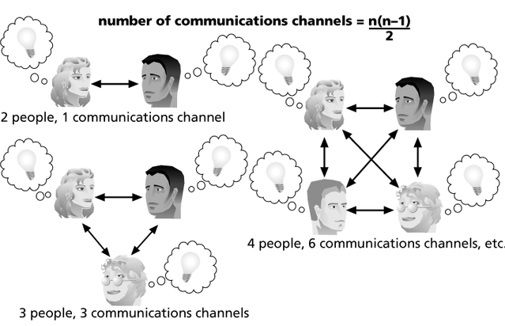
Figure 10-1. The Impact of the Number of People on Communications Channels

Slide 23
Performance Reporting
Performance reporting keeps stakeholders informed about how resources are being used to achieve project objectives.
  Status reports describe where the project stands at a specific point in time.
  Progress reports describe what the project team has accomplished during a certain period of time.
  Forecasts predict future project status and progress based on past information and trends.

Slide 24
Managing Stakeholders
Project managers must understand and work with various stakeholders.
Need to devise a way to identify and resolve issues.
Two important tools include:
  Expectations management matrix
  Issue log

Slide 25
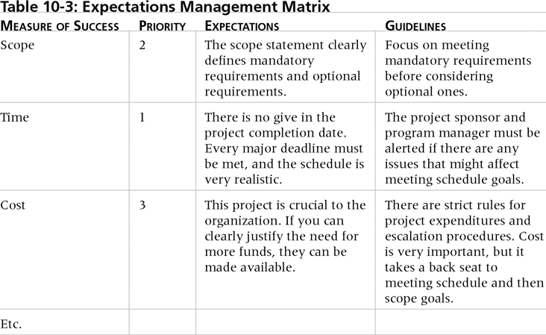
Table 10-3. Expectations
Management Matrix

Slide 26
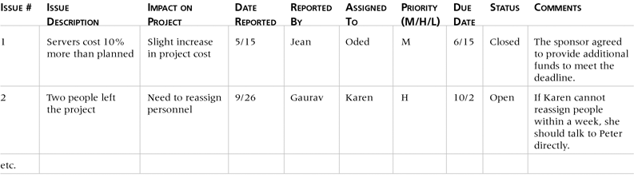
Table 10-4. Issue Log

Slide 27
Suggestions for Improving Project Communications
Manage conflicts effectively.
Develop better communication skills.
Run effective meetings.
Use e-mail effectively.
Use templates for project communications.

Slide 28
Conflict Handling Modes
Confrontation: Directly face a conflict using a problem-solving approach.
Compromise: Use a give-and-take approach.
Smoothing: De-emphasize areas of difference and emphasize areas of agreement.
Forcing: The win-lose approach.
Withdrawal: Retreat or withdraw from an actual or potential disagreement.

Slide 29
Conflict Can Be Good
Conflict often produces important results, such as new ideas, better alternatives, and motivation to work harder and more collaboratively.
Groupthink: Conformance to the values or ethical standards of a group. Groupthink can develop if there are no conflicting viewpoints.
Research suggests that task-related conflict often improves team performance, but emotional conflict often depresses team performance.

Slide 30
Developing Better Communication Skills
Companies and formal degree programs for IT professionals often neglect the importance of speaking, writing, and listening skills.
As organizations become more global, they realize they must invest in ways to improve communication with people from different countries and cultures.
It takes leadership to improve communication.

Slide 31
Running Effective Meetings
Determine if a meeting can be avoided.
Define the purpose and intended outcome of the meeting.
Determine who should attend the meeting.
Provide an agenda to participants before the meeting.
Prepare handouts and visual aids, and make logistical arrangements ahead of time.
Run the meeting professionally.
Build relationships.

Slide 32
Using E-Mail Effectively
Make sure that e-mail is an appropriate medium for what you want to communicate.
Be sure to send the e-mail to the right people.
Use meaningful subject lines.
Limit the content to one main subject, and be as clear and concise as possible.

Slide 33
Using E-Mail Effectively (cont’d)
Limit the number and size of attachments.
Delete e-mail you don’t need, and don’t open e-mail if you question the source.
Make sure your virus software is current.
Respond to and file e-mails quickly.
Learn how to use important features.

Slide 34
Using Templates for Project Communications
Many technical people are afraid to ask for help.
Providing examples and templates for project communications saves time and money.
Organizations can develop their own templates, use some provided by outside organizations, or use samples from textbooks.
Recall that research shows that companies that excel in project management make effective use of templates.

Slide 35
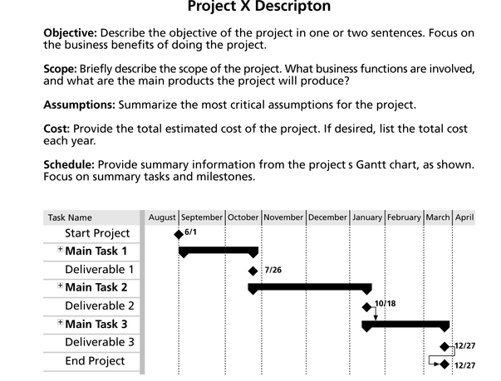
Figure 10-2. Sample Template for a
Project Description

Slide 36
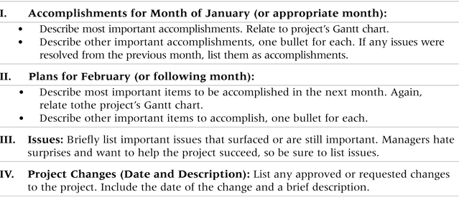
Table 10-5. Sample Template for a Monthly Progress Report

Slide 37
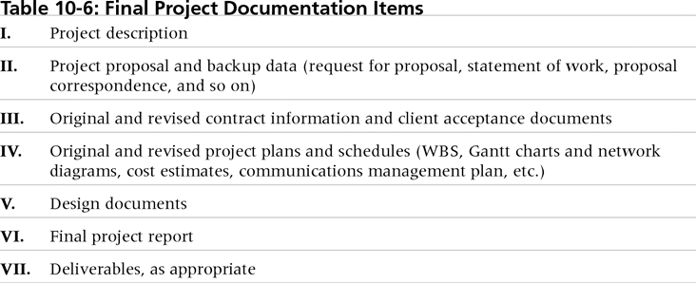
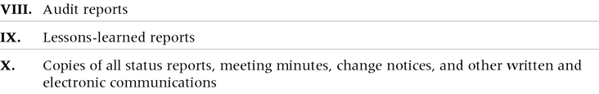
Table 10-6. Final Project
Documentation Items

Slide 38
Lessons Learned Reports
The project manager and project team members should each prepare a lessons-learned report.
  A reflective statement that documents important things an individual learned from working on the project.
The project manager often combines information from all of the lessons-learned reports into a project summary report.
See template and sample in Chapter 3.

Slide 39
Project Web Sites
Many project teams create a project Web site to store important product documents and other information.
Can create the site using various types of software.

Slide 40
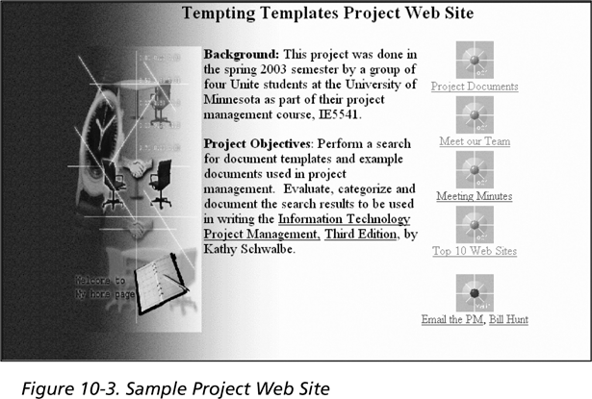
Figure 10-3. Sample Project Web Site

Slide 41
Developing a Communications Infrastructure
A communications infrastructure is a set of tools, techniques, and principles that provide a foundation for the effective transfer of information.
  Tools include e-mail, project management software, groupware, fax machines, telephones, teleconferencing systems, document management systems, and word processors.
  Techniques include reporting guidelines and templates, meeting ground rules and procedures, decision-making processes, problem-solving approaches, and conflict resolution and negotiation techniques.
  Principles include using open dialog and an agreed upon work ethic.

Slide 42
Using Software to Assist in Project Communications
There are many software tools to aid in project communications.
Today more than 37 percent of people telecommute or work remotely at least part-time.
Project management software includes new capabilities to enhance virtual communications.
New tools, such as instant messaging and blogs, can enhance project communications.

Slide 43
Chapter Summary
The goal of project communications management is to ensure timely and appropriate generation, collection, dissemination, storage, and disposition of project information.
Main process include:
  Communications planning
  Information distribution
  Performance reporting
  Managing stakeholders

